Slide 1

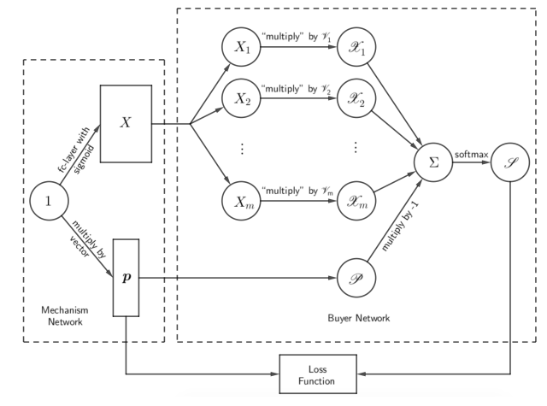
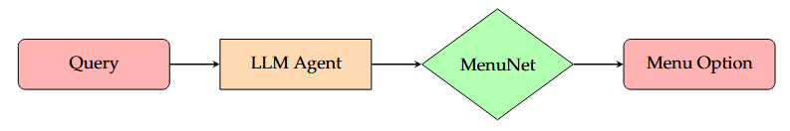
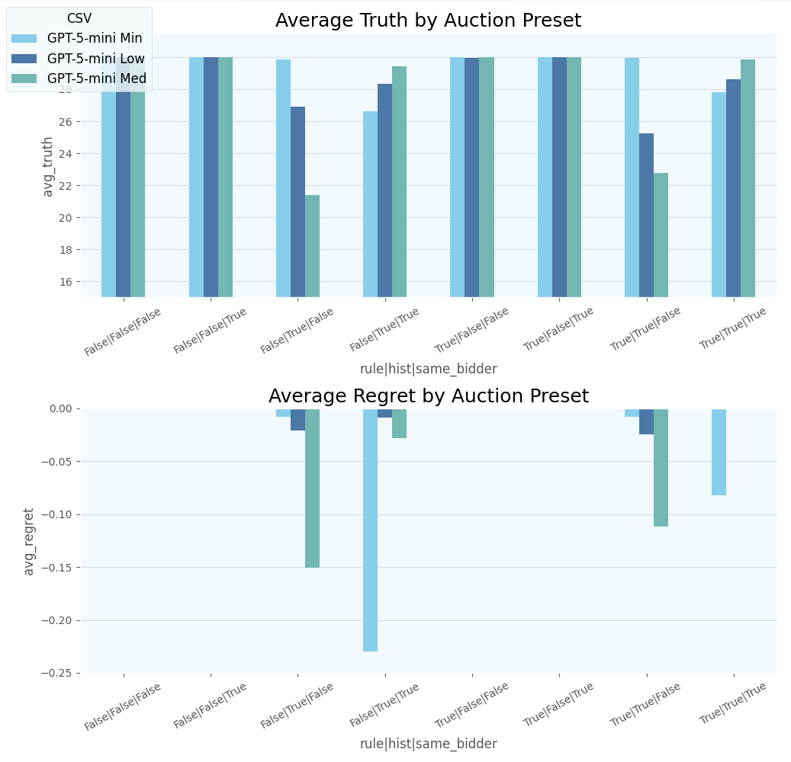
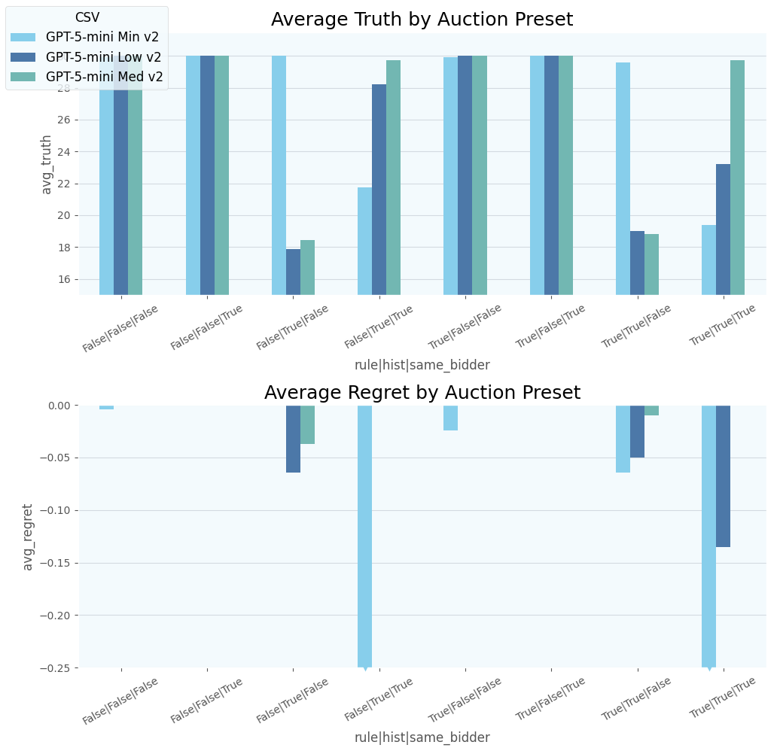
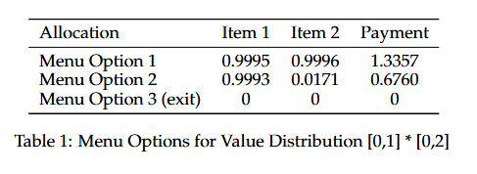
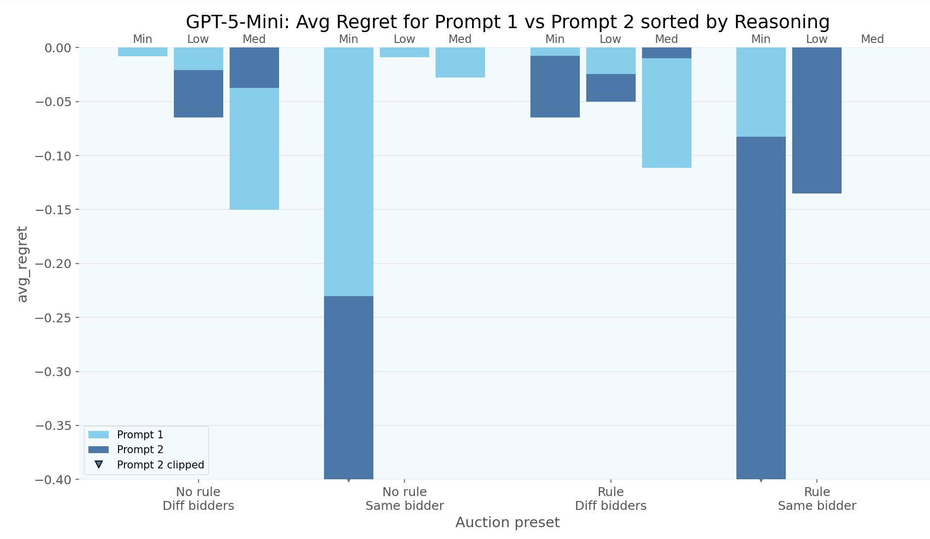
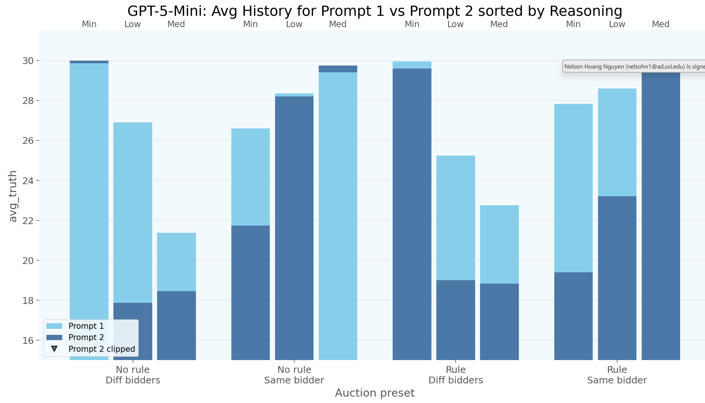
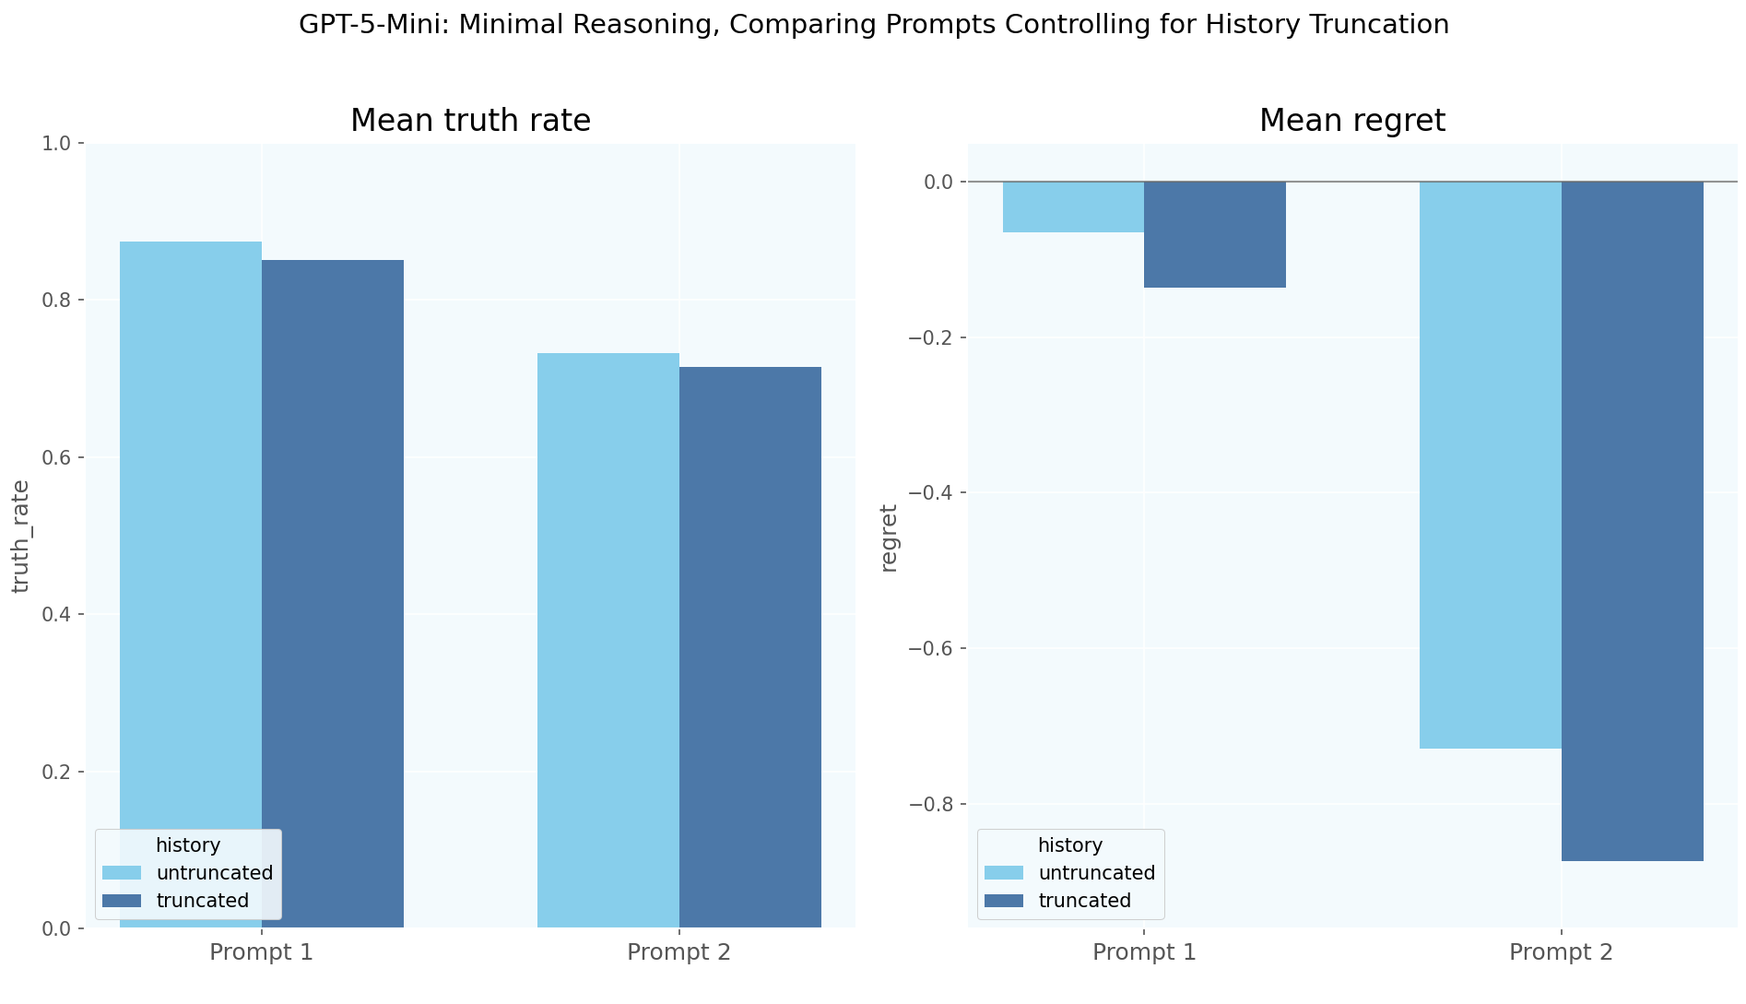
Evaluating LLM Agents
In Black Box Auctions
Nelson Hoang Nguyen
University of California, Irvine
Professor Chuan Xiao, Shuyuan Zheng
Onizuka Lab, Graduate School of Information Science and Technology
Background
MenuNet Mechanism
MenuNet is a neural network auction that consists of MechNet and BuyerNet. It takes an input of bids and outputs a singular menu option, a set containing an allocation and a payment.
Achieves incentive compatibility, in which the truthful bid is always the best bid to make.
MechNet, initializes an allocation matrix, X, and payment vector, p, and sets their values as learning parameters.
BuyerNet, inputs X and outputs a distribution representing the likelihood that certain valuation pairs are chosen; applies SoftMax over utility of all possible valuable
Training Design: Item Domains: [0,1] x [0,2]. 100 discretization, 2 items, 3 menu options, 5000 steps. Trained by optimizing loss function (negative of expected revenue)
With the recent development of large language models (LLMs), it has become possible to utilize them as bidders to automate auctions. In this study, we evaluate the bidding capabilities of LLM agents in neural network auctions. Previous research has analyzed the performance of LLM agents in other neural network mechanisms such as RegretNet. We aim to expand upon these by analyzing LLM agents’ performances in MenuNet auctions.
Implementation
Figures
Auction Design:
Domains: [0,1] x [0,2]
Single Bidder, Two Items, Three Menu Options
30 rounds, 30+ runs (For GPT-5-mini)
Parameters:
Rule: Will the LLM know how MenuNet was trained
History: Will the LLM be able to see the previous bids, menu options, and the selected option
Same Bidder: Same bidder auctions will keep the internal valuation across rounds; different bidder auctions will change valuations every round.
Model: GPT-5-mini, GPT-5.2, GPT-4o
Reasoning Effort: Minimal, Low, Medium
Prompt: Prompt 1 will not ask the agent to provide a reason; Prompt 2 asks for reasoning
Evaluation:
Truthfulness: How honest the LLM agent is. More truthful is better.
Regret: The difference in expected profit for untruthful bids. If an untruthful bid returns a different menu option than what a truthful bid would, calculates the difference in utility (valuation * allocation – payment) for both menu options. Lower Regret is better.
Prompt 1 (Above):
In same bidder: minimal reasoning model performs much worse
In different bidder auctions, the medium reasoning model perform worse
When not prompting for reason behind bids, “minimal” reasoning effort performs quite well; all regret is above -.25
Prompt 2 ( Above):
Significant improvements in performance by higher reasoning models
Prompt 2 is generally less truthful, LLM agents tend to bid untruthfully to increase chances of getting the optimal menu option (below).
For “minimal” reasoning, prompting for reasoning leads to significant regret increase (Rgt = -3+)
Conclusions
Across All Settings:
The LLM agent performs extremely well for auctions without history; 0 Regret and nearly completely truthful
This has limited use cases, as in real world setting, people will remember their previous bids or other people’s bids
The Rule setting does not have as large as an impact compared to other parameters, but does slightly improve LLM agent performance
Conclusion:
Higher reasoning LLM agents tend to perform better in auctions with history, with 5.2-mini “medium” using Prompt 2 being the best performer. Agents demonstrate complex thinking capabilities, but we observe higher reasoning models purposefully being untruthful to guarantee their best menu option, which has its own nuance.
Other Results:
Note: All models below use Prompt 2
GPT-4o performs very poorly in auctions with history, w/ lowest recorded regret being -4
GPT-5.2 with “none” Reasoning Effort performs well in different bidder auctions; poorly in same bidder auctions (similar to 5-mini “minimal”)
GPT-5.2 “low” worse than GPT-5-mini “low”, but GPT-5.2 “medium” comparable to GPT-5-mini “medium” using Prompt 1.
GPT-5.2 is less truthful compared to equivalent reasoning model in GPT-5-mini
References
Future Research:
Expand testing for GPT-5.2; testing as to why it performs worse than GPT-5-mini.
Compare different prompts for the LLM; more detailed prompts may lead to different performances, especially by none reasoning models or much higher reasoning models.
Evaluating LLM agents in auctions with different items every round; the valuation domain would change every round. This requires training for other valuation domains.
Expand auctions into much larger scales; utilizing 10+ items and 5+ menu options.
[1] Shen, W., & Tang P., & Zuo S. (2021). Automated Mechanism Design via Neural Networks. arXiv. https://arxiv.org/abs/1805.03382v2.
[2] Anon. (2024). Evaluating LLM Agents in Black Box Auctions. arXiv. https://arxiv.org/abs/2203.01862.
[3] Dütting, P., Feng, Z., Narasimhan, H., Parkes, D. C., Jones, L., Ravindranath, S. S. (2022). Optimal Auctions through Deep Learning: Advances in Differentiable Economics. arXiv. https://arxiv.org/abs/1706.03459v6.

